Slide 1
Introduction To 3D Image Reconstruction
Our presentation is just an introduction to 3d image reconstruction so we will not focus on the analysis in detail.
There is no one algorithm so it is not possible. Still we will talk about the optimizations trends and their effect.
May 22, 2018
By
Arifullah Jan | Bilal Khalid | Saqib Shakeel | Waqas Yaseen

Slide 2
What is 3d Reconstruction?
Technique to detect the 3d shape.
Methods:
Manual using tools like meshlab
UV camera
Multiple images

Slide 3
What is 3d Image Reconstruction?
Technique to detect the 3d shape using image.
We will discuss block matching algorithm
Complexity depends on the output you want
No of images
Detail in the images (texture)

Slide 4
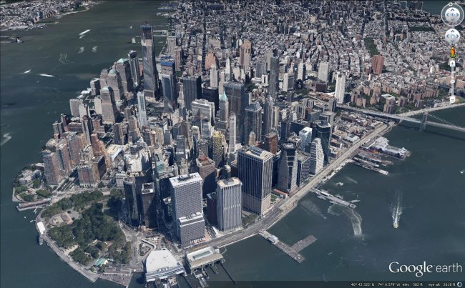
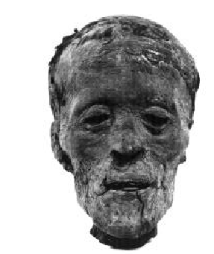
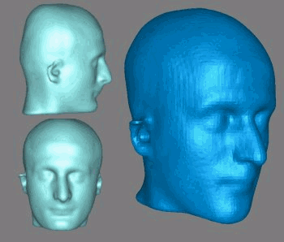
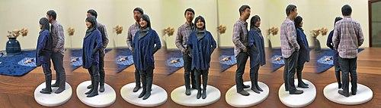
Uses

Slide 5
How do we see 3d?
We have two eyes.
3d displays show us two different images to both eyes.
Simple display shows one image.

Slide 6


Slide 7
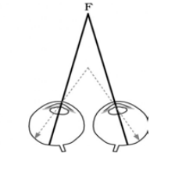
How is it done?
The basic idea is finding the distance of some point on the object from the camera.
Isn’t possible with a single picture.
How we see 3D.
We need multiple images.

Slide 8
Steps
Camera Calibration
Depth Determination
Material Application
This includes tweaking the pictures to make them suitable to be used in the algorithm.
Camera orientations etc.
Applying the texture on the mesh generated by depth determination.
The most important part of the process.

Slide 9
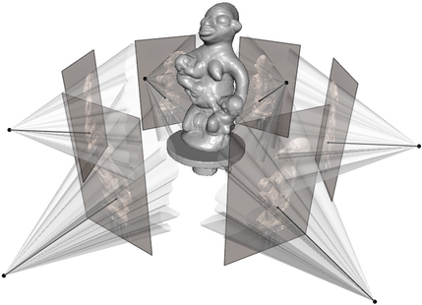
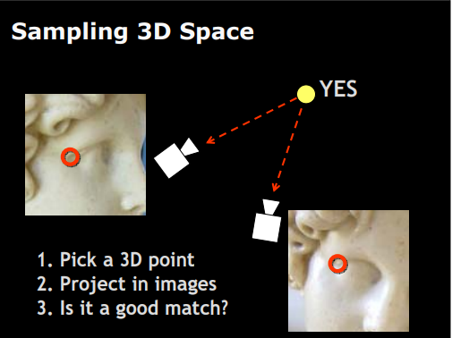
Depth Determination
Finding the distance of a 3d point from all the camera positions.
Matching a point in all images.

Slide 10
Algorithm
For every point
in every image
match the point(with all points)
in all images.
Quite complex….

Slide 11
Naive Algorithm Analysis
x*x points in one image
20 images
x^2(points in the subject image) * 19 (no of images) * x^2 (total blocks)
We have to do this for all images…
A single image can’t have all the 3d points present.
Not feasible at all

Slide 12
Optimizations - Blocks instead of pixels
No sense, doing depth determination at pixel level.
Extremely resource hungry.
Unsatisfying results.
Blocks are used
Grouping into blocks is done through complex algorithms.

Slide 13
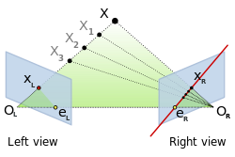
Optimizations-Epipolar Line
Search the point in the epipolar line only.

Slide 14
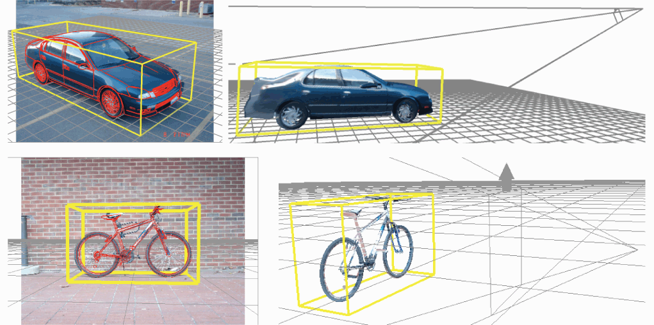
Optimizations-Object Detection
Detect the object.
Ignore all other blocks

Slide 15
Algorithm
For every block - in every image
match the block in line - in all images.
The algorithm time
Depends on the output you want.
The optimizations you want.

Slide 16
Optimized Algorithm Analysis
x*x blocks in one image
20 images
Around x blocks in one line
x^2(points in the subject image) * 19 (no of images) * x (blocks in line)
We have to do this for all images…
A single image can’t have all the 3d points present.

Slide 17
Thank you

